Slide 1



Our Children Are
Not For Sale!
Presenter- Jennifer Reynolds

Slide 2


Brief History of Goals 2000, “School to Work” and “College Readiness” Programs in the United States
“Education for Sustainable Tyranny- The UN Agenda for America’s Children”- Michael J. Chapman DVD
  Workforce Investment Act (1998)- Managing K-80 Knowledge Supply
  “Merging Factory with Schools.”
  Goals 2000 (Educate America Act)- Started in the 1990’s under President Clinton. Failed to established national standards, assessments and data mining- Rejected by the states. However, under President George W. Bush in 2001, No-child-left-behind (NCLB) was created to proliferate these goals.
  “Workforce Planning Boards- appointed by the Governors in the states.” We have these Councils in AZ! These started as the P-20 Council: P=Preschool and 20= stands for age 20 (2-yrs college). Now AZ has the “AZ Ready Education Council.”
  Minnesota is the “pilot” Workforce State which all other
  states are modeled after.
  Planned economies do not work- we cannot match
  students to a particular career path! This goes against
  the “free enterprise” system as well that Americans have
  come to enjoy.
Notes:
How did we get involved in data mining? There has been a push since the early 1990’s through the “Workforce Investment Act” and the “Educate America Act” to have “school to work” boards to promote college readiness. It started under the Clinton Administration but these ideas were rejected by the state. However in 2001, No-child-left-behind was introduced and these goals were proliferated “merging factories with schools” by establishing “Workforce Planning Boards” or “P-20” Councils. Planned economies do not work and go against our “free enterprise” system we have come to love in America!

Slide 3

How were K-12 “College Readiness” and
“Workforce” Programs Established in AZ?
The Governor’s P-20 Council was created in August 2005 by former Governor Janet Napolitano with Executive Order 2005-19 and then replaced with EO 2005-26 (http://www.azlibrary.gov/is/state/eo/2005-26.pdf). “The P-20 Council was to consist of:
  4 members from the AZ Legislature to serve as ‘exec-officio members;’
  The Superintendent of Public Instruction;
  A member of the AZ Board of Regents who is a member of the Joint Conference Committee (JCC);
  AZ’s three State University Presidents (ASU, NAU, UofA);
  Not more that four Community College representatives (one of which has to be a member of the JCC);
  Two Superintendents of the Joint Technological Education Districts (one had to be from a rural district and one from a urban district);
  Three P-12 Education Representatives;
  A Member of the State Board of Education;
  A Member of a Private Post-Secondary Institution;
  A Representative of Governor’s Council on Innovation and Technology;
  A Representative of Governor’s Council on Workforce Policy;
  Not more 8 members of the public representing parents groups, business and industry;
  A Representative of the Governor’s School Readiness Board;
  A Representative of the high school drop out programs or policy;
  A Student Representative of a high school or post secondary education;
  A Tribal Representative;
  Not more than 2 elective officials.”
“The P-20 Council shall explore ways Arizona can achieve a more effective, efficient and equitable education pipeline.”
Notes:
Governor Napolitano setup our P-20 Council in Arizona with Executive Orders (EO’s) 2005-19 and EO 2005-2006. This P-20 Council was to “explore ways Arizona can achieve a more effective, efficient and equitable education pipeline.”

Slide 4
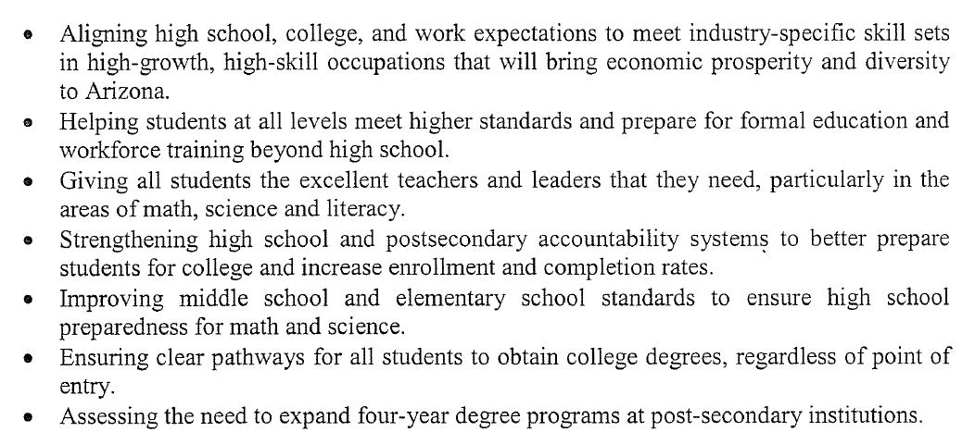
K-12 “College Readiness” Programs in AZ-
P-20 Readiness Council Responsibilities
Notes:
The P-20 Council, under Governor Napolitano, was to “align high school, college, and work expectation to meet industry-specific skill sets in high-growth, high skill occupations that will bring economic prosperity and diversity to Arizona.” They were also tasked to “help students at all levels meet higher standards and prepare for formal education and workforce training beyond high school.”

Slide 5
P-20 Readiness Council Replaced By
Arizona Ready Education Council (AREC)
Governor Janet Brewer replaced the “P-20 Ready Council” with the “AZ Ready Executive Council” (AREC) in 2011 with Executive Order 2011-8. “The membership of this AZREC would include:
  The Superintendent of Public Instruction;
  The President of the State Board of Education;
  The President of the Arizona Board for Charter Schools;
  The President of the Arizona Board of Regents;
  The Chairperson of the Arizona Community College Presidents’ Council;
  The President of the Arizona Commerce Authority;
  A County School Superintendent;
  A Chairperson of a statewide business organization;
  A Representative from a Joint Technical Education District;
  A Representative from a parent’s organization;
  A Representative of a community organization;
  A Representative from an education service relation foundation or philanthropic organization;
  A current or former teacher;
  A current of former principal or superintendent;
  Two “at large business leaders;
  A business leader from rural or southern Arizona.”
“The members serve at the pleasure of the Governor.” What does that mean??
Notes:
The P-20 Council was replaced by another Executive Order, under Governor Jan Brewer, and renamed to the “Arizona Ready Education Council” (AREC) by Executive Order (EO) 2011-8. Our public members went down from 9 individuals down to 3 under this new “Arizona Ready” board and their duties were now to “serve at the pleasure of the Governor.” What does that mean?

Slide 6
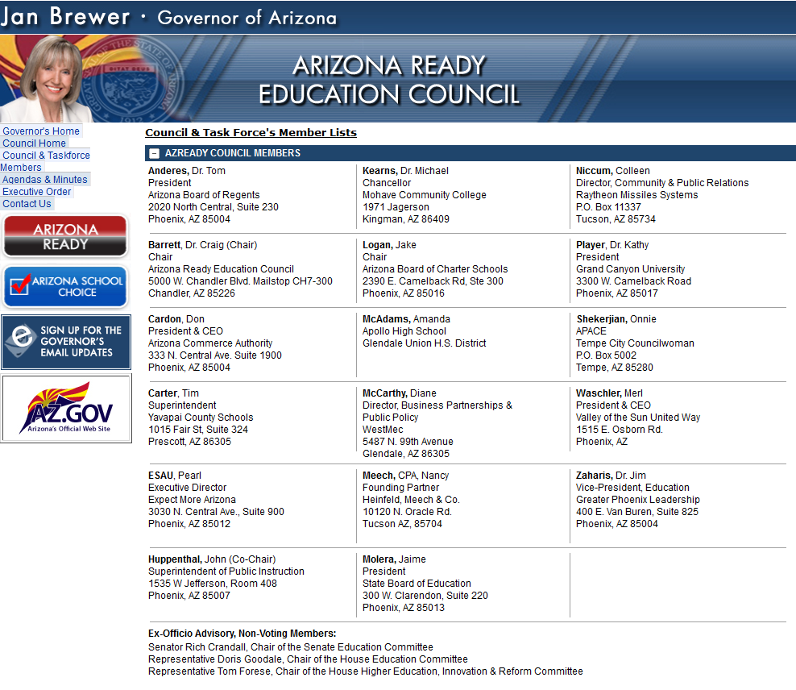




Arizona Ready Education Council Members-Prior to 2015
(http://www.azgovernor.gov/AzReady/Members.asp)
Notes:
This is what the P-20, “Arizona Ready” Council looked like under Governor Brewer. Dr. Craig Barrett (former CEO of Intel and Achieve Chairman of the Board) is serving as the Council Chairman. Superintendent Huppenthal is a member along with Senator Rich Crandall, Representative Doris Goodale and Tom Forese. Interesting to note, Senator Rich Crandall and Representative Doris Goodale pushed for all of the Common Core legislation in our state establishing funding for SLDS, PARCC and data mining.

Slide 7
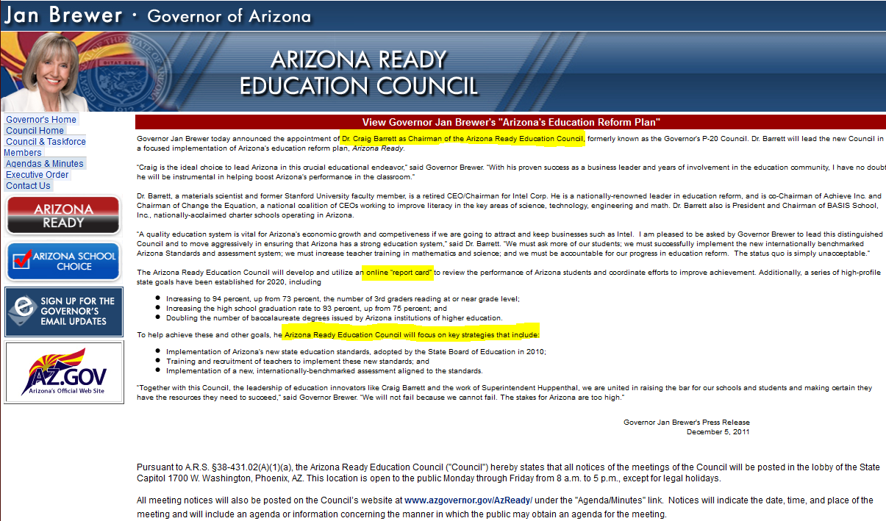
Arizona Ready Education Council Taskforce Responsibilities- Prior to 2015
Notes:
These are the responsibilities of the “Arizona Ready Education Council” under Governor Brewer prior to 2015.

Slide 8
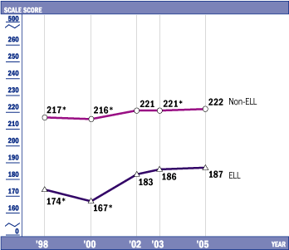
Why is No-Child-Left-Behind (NCLB) and Arizona’s Instrument to Measure Standards (AIMS) a failure in AZ?
(http://www.schoolsmatter.info/2006/08/english-language-learners-tossed-into.html)
This article from the Arizona Republic was written in 2006 and it states:
“This year Arizona has tripled its number of failing schools.
Credit can be given to insane NCLB requirements, which demand
the inclusion of test scores for new immigrants, many of whom who
do not speak English. This kind of thuggish requirement, which is
not limited at all to Arizona, represents a blatant disregard for public
schools, teachers, and the students who can't read the tests they are
given.”
“The main reason: Federal officials changed the rules. “For the first time
ever the state was forced to include AIMS (teaches-to-the-test and not a
measure of student achievement) test results in math and reading from
students who are in their second or third year of learning English.”
“The contrast highlights a debate that is playing out among educators over how Arizona should measure its educational performance?” State officials want to exclude students in their first three years of language learning from the federal ‘adequate yearly progress’ counts, expected to be released Friday. They also separate them from Arizona's annual ranking of schools and overall AIMS exit-exam results. They argue that including students still learning English skews the picture.”
With NCLB, all students were slowed down to make sure everyone in the class passed- this breeds mediocrity!
National Education Assessment Progress (NAEP) English Language Learners (ELL) vs. Non-English Language Learners (Non-ELL)
Notes:
I left his slide in this presentation from my “Common Core Rotten to the Core” presentation to show why NCLB was a failure in our state.

Slide 9
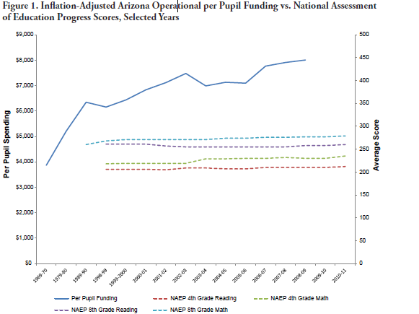
Has more Federal and State Money spent made our students smarter over the years?
Source: National Center for Education Statistics (NCES), “Digest of Education Statistics: 2011,” Table 194, http://nces.ed.gov/programs/digest/d11/tables/dt11_194.asp
Notes:
I kept this graph in my presentation as well to show you that increases in federal funding for federal programs does not equate to “higher achievement” in students. As seen from this graph, despite more money spent, year after year, we have not seen an improvement in the National Assessment of Education Progress Scores for 4th and 8th grade Reading and Math!

Slide 10


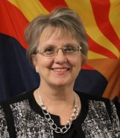


Arizona Ready Council in 2015! http://arizonaready.com/council/
Former CEO Intel
Achieve Chairman of the Board
Basis School owner
SBE Member
P-20 Council
member on
RTTT Phase I .
“Teacher of the Year” 2011. Big lobbyist group at the Capitol
Big lobbyist
group at the Capitol and Community
Big lobbyist
group at the Capitol and Community
Big lobbyist
group at the Capitol and Community
Last time this council met was in September 2014!
Notes:
This is what the “Arizona Ready” Council looks like today in 2015. The folks that I circled are all the people that I have testified against at the Capitol who were opposing our Anti-Common Core legislation or we have presented against in our communities since 2013. This “Arizona Ready” group has not met thus far in 2015. Superintendent Douglas is supposed to be a member of this Council, but as I said, their website has not been updated nor have they met thus far this year. However, we do have letters published at the “Arizona Daily Independent” newspaper showing these members discussing how they are going to fight our bill HB2190 (Common Core Repeal and Replace) this legislative session!

Slide 11
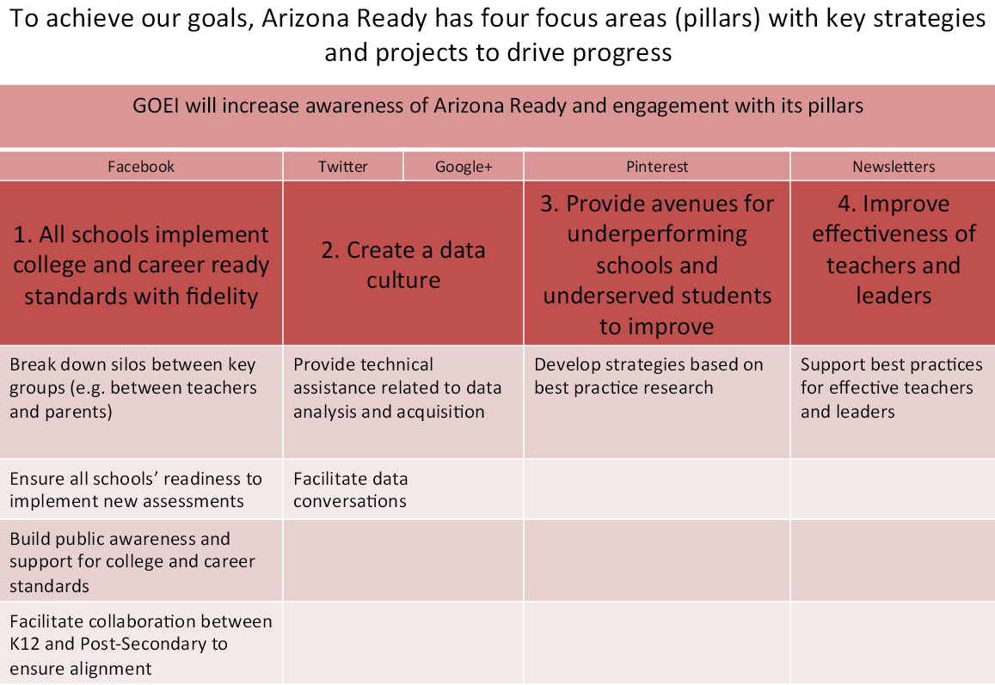
Arizona Ready Goals- 2013 http://arizonaready.com/files/pdfs/Delivery_Plan.pdf
Notes:
These were the “Arizona Ready” Goal in 2013: 1. All schools will implement college and career ready standards with fidelity. 2. Create a data culture. 3. Provide avenues for underperforming schools and underserved students to improve. 4. Improve effectiveness of teachers and leaders.

Slide 12
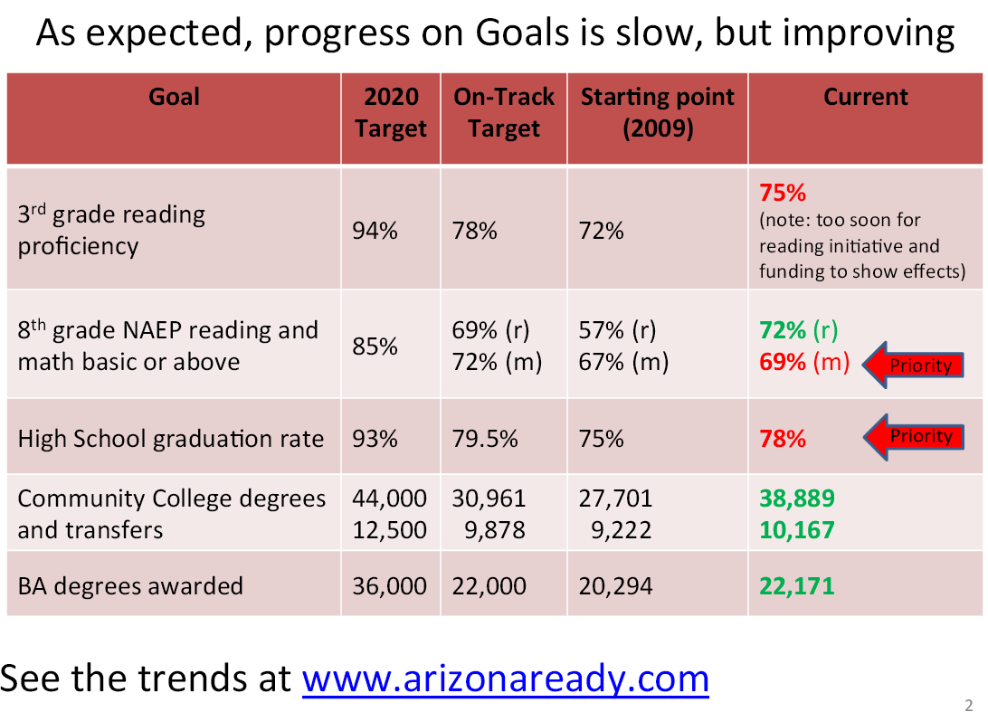
Arizona Ready Goals- 2013 Progress http://arizonaready.com/files/pdfs/Delivery_Plan.pdf
Notes:
This is the Progress of those Goals in 2013.

Slide 13
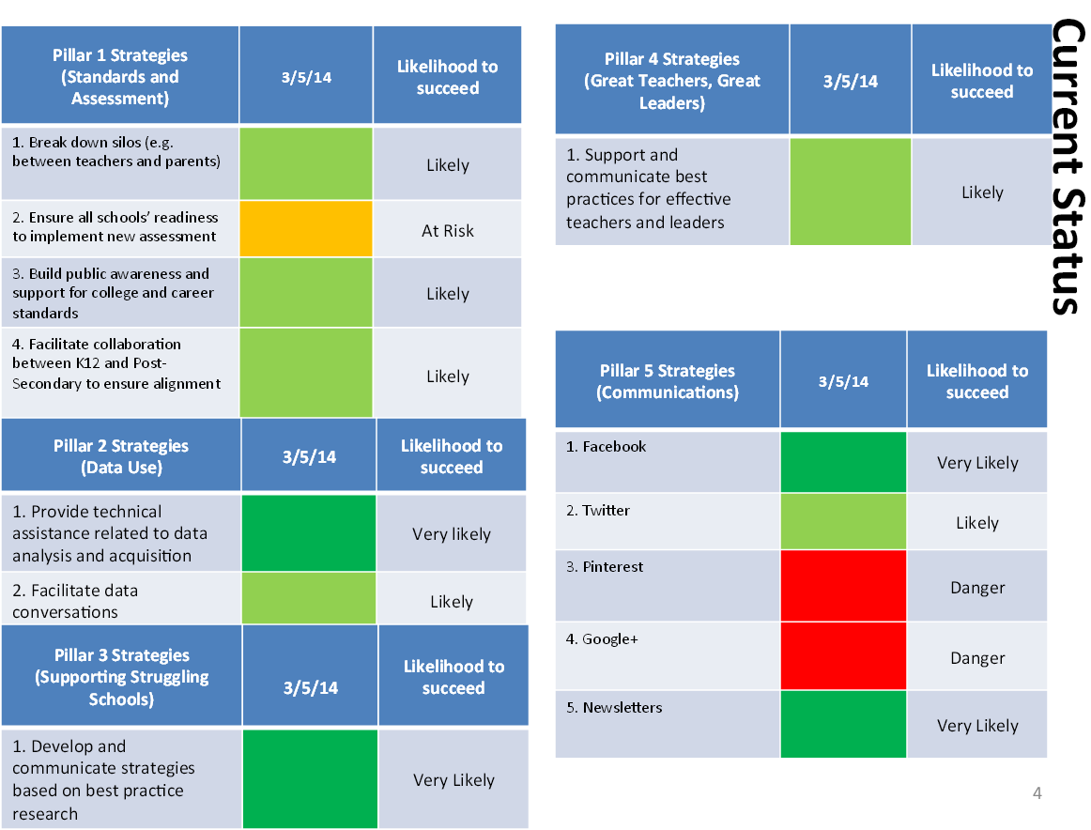
Arizona Ready Goals- 2014 Current Status http://arizonaready.com/files/pdfs/Delivery_Plan.pdf
Notes:
This is the 2014 “Current Status” of the four goals and their “pillar strategies.”

Slide 14
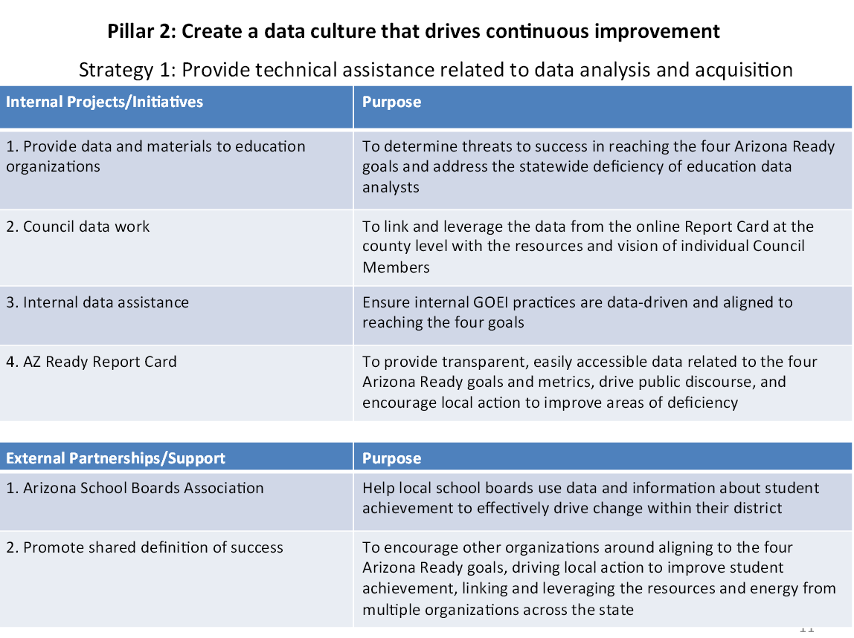
Arizona Ready- Pillar 2 (Data Use) http://arizonaready.com/files/pdfs/Delivery_Plan.pdf
Notes:
I’m going to focus on “Pillar 2” since that is where data collection is discussed.

Slide 15
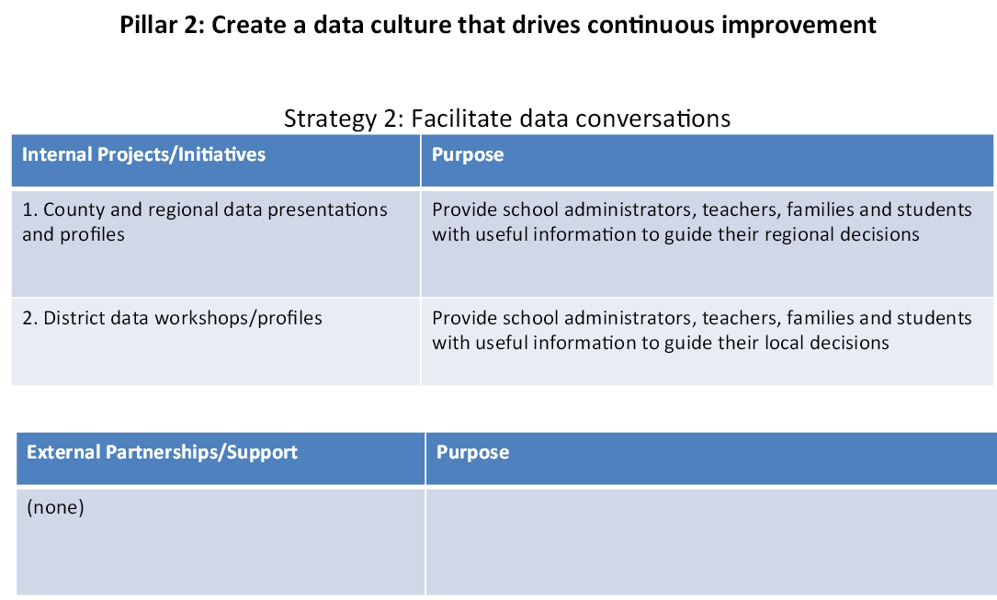
Arizona Ready- Pillar 2 (Data Use cont..) http://arizonaready.com/files/pdfs/Delivery_Plan.pdf
They say we are not sharing with external partners but we know we are sharing data with “outside entities” and “external partners.”
Notes:
“Arizona Ready” is claiming that Arizona is not participating in “external partnerships” where data us shared with “outside entities.” We have proof that that is not true!

Slide 16

Family Education Rights to Privacy Act (FERPA)-
Before Executive Order (EO) 12866! http://www2.ed.gov/policy/gen/guid/fpco/ferpa/index.html
“The Family Educational Rights and Privacy Act (FERPA) (20 U.S.C. § 1232g; 34 CFR Part 99) is a Federal law that protects the privacy of student education records. The law applies to all schools that receive funds under an applicable program of the U.S. Department of Education.”
“FERPA gives parents certain rights with respect to their children's education records. These rights transfer to the student when he or she reaches the age of 18 or attends a school beyond the high school level. Students to whom the rights have transferred are ‘eligible students.’”
“Generally, schools must have written permission from the parent or eligible student in order to release any information from a student's education record. However, FERPA allows schools to disclose those records, without consent, to the following parties or under the following conditions”(34 CFR § 99.31):
  School officials with legitimate educational interest;
  Other schools to which a student is transferring;
  Specified officials for audit or evaluation purposes;
  Appropriate parties in connection with financial aid to a student;
  Organizations conducting certain studies for or on behalf of the school;
  Accrediting organizations;
  To comply with a judicial order or lawfully issued subpoena;
  Appropriate officials in cases of health and safety emergencies; and
  State and local authorities, within a juvenile justice system, pursuant to specific State law.
“Schools may disclose, without consent, ‘directory’ information such as a student's name, address, telephone number, date and place of birth, honors and awards, and dates of attendance. However, schools must tell parents and eligible students about directory information and allow parents and eligible students a reasonable amount of time to request that the school not disclose directory information about them. Schools must notify parents and eligible students annually of their rights under FERPA. The actual means of notification (special letter, inclusion in a PTA bulletin, student handbook, or newspaper article) is left to the discretion of each school.”
Notes:
Before I get into what data is shared, I felt it was important to talk about the Family Education Rights to Privacy Act (FERPA). This is what FERPA protected before Obama wrote Executive Order (EO) 12866 in April 2011.

Slide 17

Family Education Rights to Privacy Act (FERPA) Stripped-
After Clinton’s EO 12866 and solidified under Obama in 2012 http://www.newswithviews.com/Hoge/anita116.htm http://www.air.org/resource/reauthorizing-higher-education-act-role-consumer-information-college-choice
Allows our children's personally identifiable information (PII) data to flow to “outside contractors.”
Obama referred to this tsunami of data to vendors, businesses, foundations, higher ed, and corporations as "unlocking" the data.
Clinton and Obama have stripped our children of their privacy and undressed their psyches for ANYONE to track and traffic attitudes, values, beliefs, and dispositions for research and reeducation programs.
DNA sequences are also up for grabs.
“Unlocking of data” contributed to sharing and creation of a state longitudinal data system (SLDS) in every state that the NCES/IES funded “and created a ‘unique National ID’ number that is tracking every person in the United States.
Pennsylvania was a model state that developed this privacy invading "womb to workplace" system monitoring individuals from birth through retirement including collecting data on wages.
The federal government is collecting this personally identifiable information on its citizens. But worse, the interventions to align our children's attitudes, values, beliefs, and dispositions to Common Core, SCANS interpersonal skills are totalitarian.
The behavioral data analysts also want to cross-match state employment data with the federal Internal Revenue System (IRS) and Social Security Administration (SSA) System with these databases!
President Clinton's Executive Order 12866, was reviewed and fully implemented by Obama in January 2012 with EO 13563. EO 12866 is a revolving open door for child abuse and child endangerment. Parents, call Congress again and again to overrule EO 12866 and stop the abuse of our children. Congress, listen, we parents are speaking. This data tracking, trafficking, and psychological treatment (RTI) must stop!
Notes:
This is how FERPA was stripped after President Clinton’s EO 12866 and solidified with Obama’s review in 2012 with EO 13563!

Slide 18
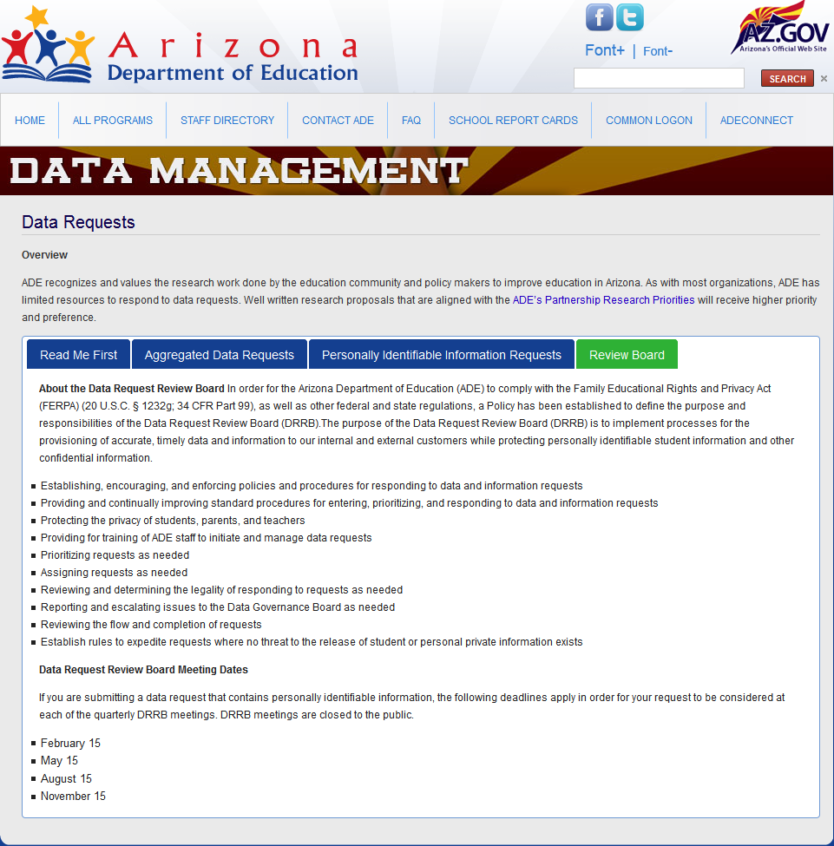

Arizona Department of Education (ADE)-
Data Request Review Board (DRRB) http://www.azed.gov/data/data-requests-2/
Notes:
The “Data Request Review Board” (DRRB) is the organization under the Arizona Department of Education (ADE) where data sharing occurs for “Aggregated” Data and “Personal Identifiable Information” Data.

Slide 19


Definitions- Aggregated Data vs.
Personally Identifiable Information (PII) data http://www.ed.gov/programs/titleiparta/reportcardsguidance.doc
Aggregated Data Definition- data that is summarized in groups for statistical purposes. Under NCLB, “all States and LEAs must collect and report information on their academic assessments in reading/language arts and math (and science beginning in 2007-08), AYP results, and teachers’ qualifications. Many of these data elements must be disaggregated by Federally-defined subgroups, necessitating the collection of student demographic information. A full discussion of Federal NCLB Report Card requirements can be found in non-regulatory guidance issued on September 12, 2003 by the U.S. Department of Education.” This data can include a student’s school, identification number, family contact information, test scores, report card, etc.
Personally Identifiable Information (PII)- is information that can be used on its own or with other information to identify, contact, or locate a single person, or to identify an individual in context. This data is a “personal identifier” which can include, but is not limited, to: a student’s school, identification number which is tied to the following: vaccination records; a social security number; birth place; mother’s maiden name; a “biometric record” (a record of one or more “biological” or “behavioral” characteristics that can be used to recognize an individual. For instance, a psychologist’s behavior evaluation, fingerprints, iris and retina scans, facial recognition, voice prints, handwriting samples, etc.); school surveys; etc.
Notes:
These are the definitions for “Aggregated Data” vs. “Personal Identifiable Information” (PII) data.

Slide 20

Definitions- Aggregated Data vs.
Personally Identifiable Information (PII) http://www.ed.gov/programs/titleiparta/reportcardsguidance.doc
Data is being collected on our children and shared with “outside entities” for research and with the federal government.
Aggregated Data Definition- data that is summarized in groups for statistical purposes. Under No-child-left-behind (NCLB), “all States and Local Education Agencies (LEAs) must collect and report information on their academic assessments in reading/language arts and math (and science beginning in 2007-08), AYP results, and teachers’ qualifications. Many of these data elements must be disaggregated by Federally-defined subgroups, necessitating the collection of student demographic information. A full discussion of Federal NCLB Report Card requirements can be found in non-regulatory guidance issued on September 12, 2003 by the U.S. Department of Education.” This data can include a student’s school, identification number, family contact information, test scores, report card, etc. Now NCLB= The Elementary and Secondary Education Act (ESEA).
Personally Identifiable Information (PII)- is information that can be used on its own or with other information to identify, contact, or locate a single person, or to identify an individual in context. This data is a “personal identifier” which can include, but is not limited, to: a student’s school, identification number which is tied to the following: vaccination records; a social security number; birth place; mother’s maiden name; a “biometric record” (a record of one or more “biological” or “behavioral” characteristics that can be used to recognize an individual. For instance, a psychologist’s behavior evaluation, fingerprints, iris and retina scans, facial recognition, voice prints, handwriting samples, etc.); school surveys; etc.
Notes:
These are the definitions for “Aggregated Data” vs. “Personal Identifiable Information” (PII) data.

Slide 21
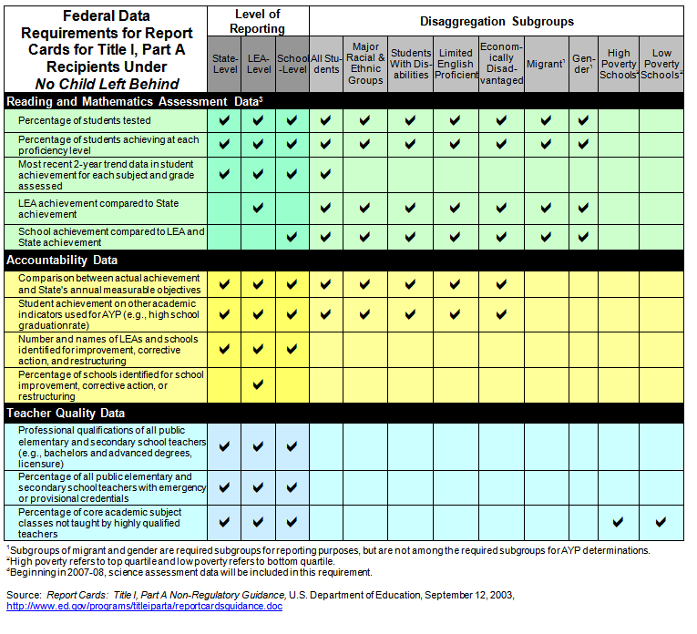
Definitions- Aggregated Data vs.
Disaggregated Data http://www.ed.gov/programs/titleiparta/reportcardsguidance.doc
Notes:
This is the “Aggregated” vs. “Disaggregated” data that is shared with the federal government under NCLB.

Slide 22
Definitions- Data Mining, Affective Domain and Statewide Longitudinal Data Systems (SLDS) http://serc.carleton.edu/NAGTWorkshops/affective/intro.html http://www.newswithviews.com/Hoge/anita108.htm
Data Mining- the process of collecting, searching through, and analyzing a large amount of data in a database, as to discover patterns or relationships. Under Common Core it is used to determine a “career path” or “human capitol” for a “career to work.”
Affective Domain- creating psychological profiles and molding "human capital" with values, beliefs and dispositions without parental or student knowledge or consent. The federal government now wants “to use schools to catalogue attributes, dispositions, social skills, attitudes and intrapersonal resources independent of intellectual ability,” all under the guise of education. (http://www.ed.gov/edblogs/technology/files/2013/02/OET-Draft-Grit-Report-2-17-13.pdf ) The Statewide Longitudinal Data System (SLDS) is an integral tool tying the Common Core Standards with the Common Core assessments (AzMERIT, PARCC, SBAC, etc.) and the “politically correct” curriculum.
Statewide Longitudinal Data Systems- Statewide data system that reports aggregated and PII data to the federal government. Funding is contributed to the state to establish the “data framework” and “data reporting structures” through federal grants and through local legislative budgets.
Notes:
These are the definitions for “Aggregated Data” vs. “Personal Identifiable Information” (PII) data.

Slide 23
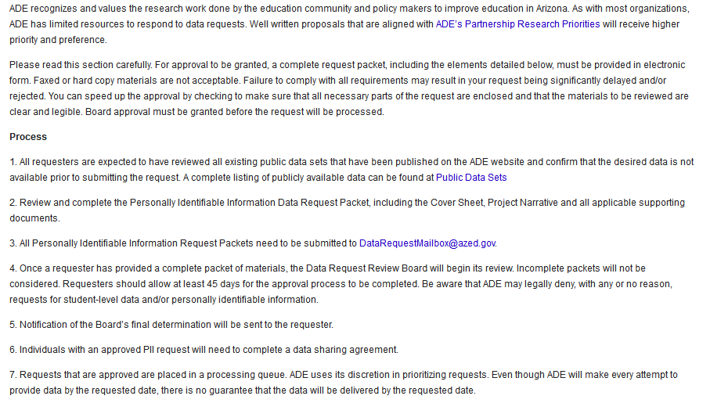
ADE Data Request Review Board (DRRB)-
Personal Identifiable Information (PII) http://www.azed.gov/data/data-requests-2/
Notes:
The “Data Request Review Board” has a process on how they share PII data with “outside entities” for research. They have “ADE Research Partnership Priorities” which outlines which companies they share student data with. This document posted is from June 2011 and is out-of-date. “Arizonans Against Common Core” and “Opt Out AZ” are working with the DRRB to have more transparency to the companies we are sharing data with on the Ade website.

Slide 24
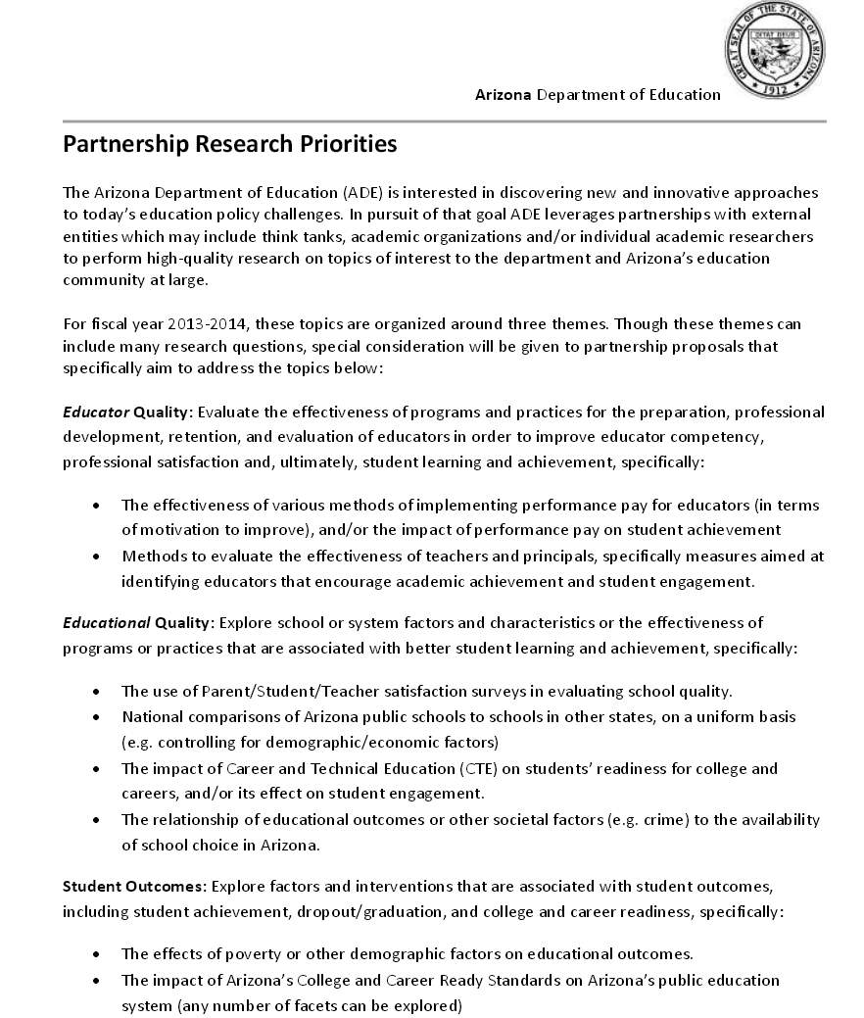
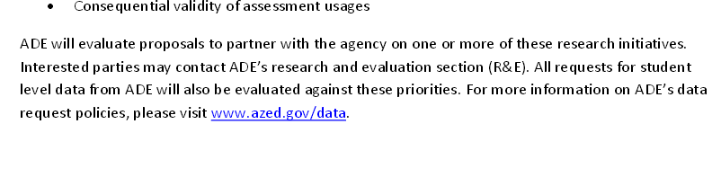
ADE Partnership Research Priorities- Page 1 http://www.azed.gov/research-evaluation/files/2011/06/ade-external-research-parternship-priorities.pdf
Notes:
This is the “ADE Partnership Research Priorities Document” that was published in June 2011. The contracts we currently have with “outside entities” that are published on the ADE website are out-of-date. We are working with the ADE to improve “transparency” and make sure all the “outside entities” our state is working with is published and up-to-date!

Slide 25
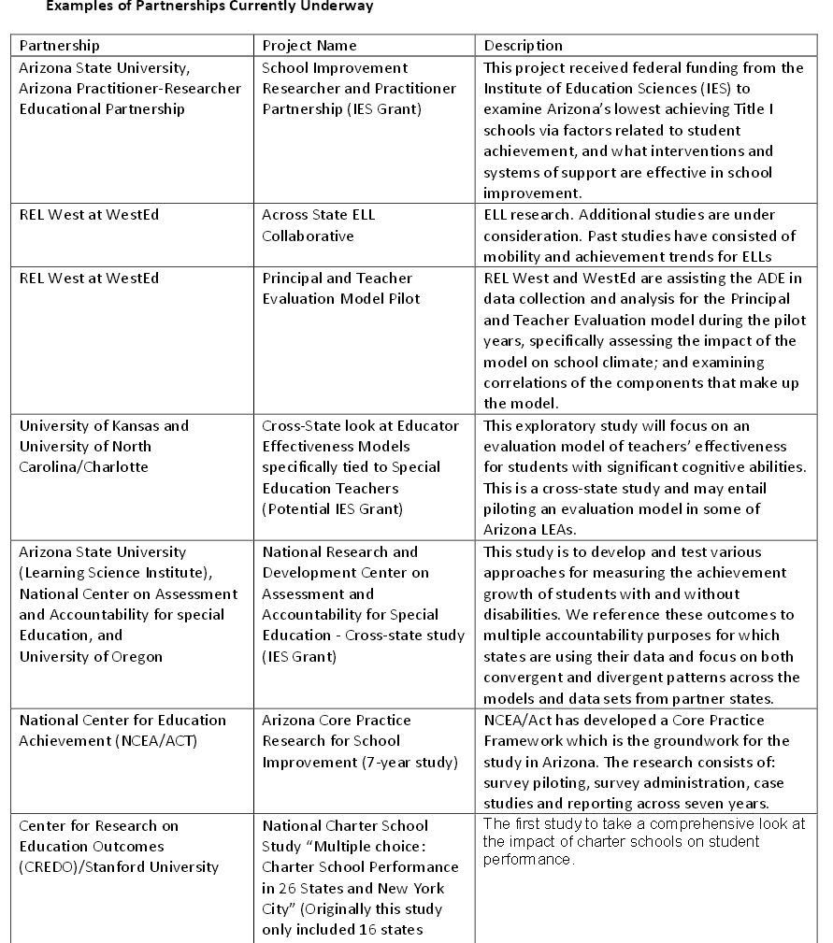
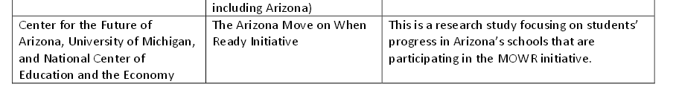
ADE Partnership Research Priorities- Page 2 http://www.azed.gov/research-evaluation/files/2011/06/ade-external-research-parternship-priorities.pdf
Notes:
These are some of the research companies and projects we have worked on with “outside entities” in the past from 2011-2014.

Slide 26
Current Unanswered Questions by the
Data Request Review Board (DRRB) http://www.azed.gov/research-evaluation/files/2011/06/ade-external-research-parternship-priorities.pdf
Arizona Research Partners as of 6/2011:
Center for the future of Arizona, University of Michigan and National Center of Education and the Economy (NCEE- Marc Tucker’s organization) http://www.arizonafuture.org/mowr/cfa-role.html
http://www.ncee.org/programs-affiliates/excellence-for-all/participating-states-and-schools/#arizona
  30 Arizona Schools are participating in “Move on when reading” (MOW) study. What data was shared with NCEE?
Do we still have a partnership with the "National Center on Assessment and Accountability for Special Education" (NCAASE)? This was also active in 2012.
http://www.ncaase.com/
http://www.ncaase.com/docs/AZ_Learns_and_A-F_Letter_Grades040512.pdf
What about the partnership with the National Center for Education (NCEA/ACT)? Apparently "Expect More Arizona" was partnered with this group in 2012:
http://www.expectmorearizona.org/blog/tag/national-center-for-educational-achievement/
I also found this document from a local school:
http://edweb.tusd.k12.az.us/uhs/The%20National%20Center%20for%20Educational%20Achievement.pdf
What about the "Center for Research on Education outcomes" (CREDO). This document was published in 2009:
http://credo.stanford.edu/reports/statepressreleases/Arizona.pdf
What abut the "REL West at WestEd" partnerships which focus on disability studies. This started in 2012 and appears to have reports through 2014:
https://relwest.wested.org/
Notes:
These are unanswered questions with the DRRB we have on the “Arizona Research Priorities” document dated June 2011.

Slide 27
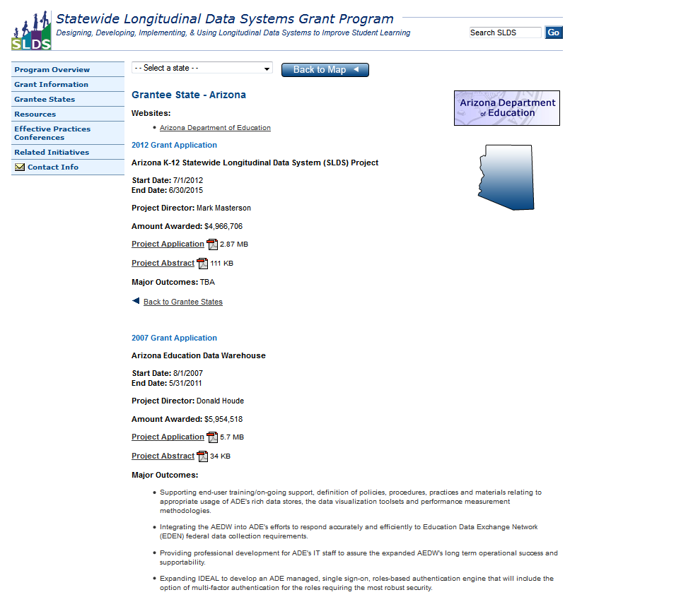

Personal Identifiable Information (PII) is being shared with
“outside entities”- Statewide Longitudinal Data Systems (SLDS)
https://nces.ed.gov/programs/slds/state.asp?stateabbr=AZ
Notes:
The National Center for Education Statistics reports the current status of the states on the Statewide Longitudinal Data System including the grants each state has received. The SLDS system will be used to report PII data to the federal government on our children. Our SLDS system is setup under our “AZ Dash –Accelerating Student Achievement” website at the ADE (AELAS- Arizona Learning Accountability System)

Slide 28
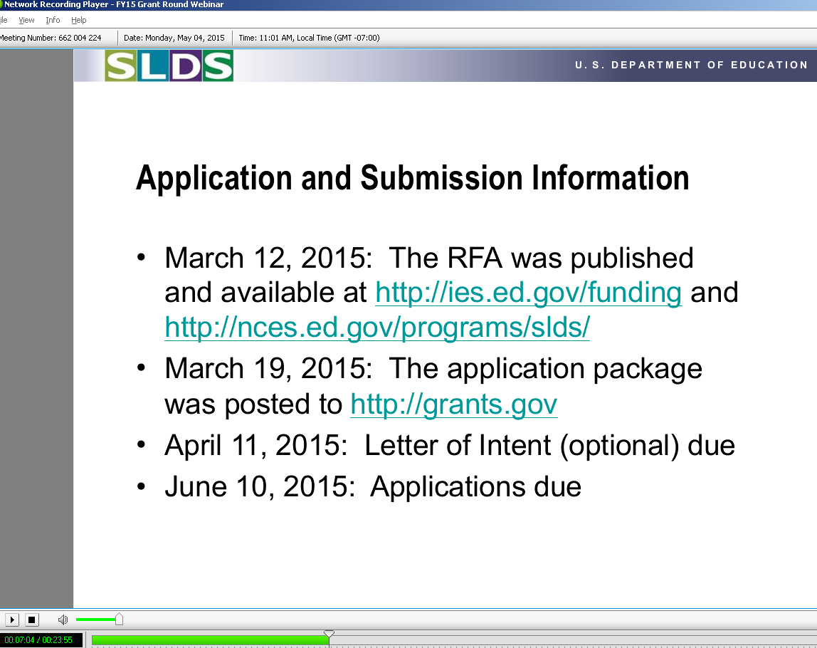
Statewide Longitudinal Data Systems (SLDS) –
Current 2015 Funding Application
https://nces.ed.gov/programs/slds/grant_information.asp
Notes:
The National Center for Education Statistics reports the current status of the states on the Statewide Longitudinal Data System including the grants each state has received. The SLDS system will be used to report PII data to the federal government on our children. Our SLDS system is setup under our “AZ Dash –Accelerating Student Achievement” website at the ADE (AELAS- Arizona Learning Accountability System)

Slide 29
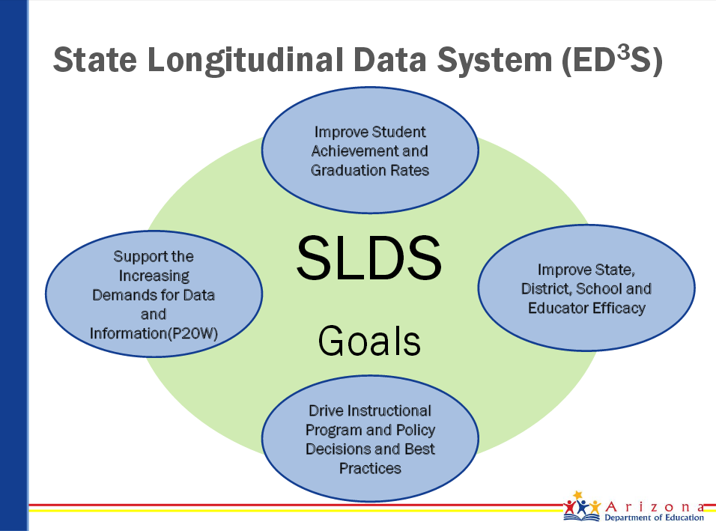
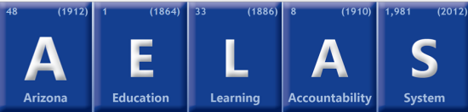

Arizona Dash- “Arizona Education Learning Accountability” System (AELAS) reports SLDS Data http://www.azed.gov/aelas/az-dash/
http://www.azed.gov/information-technology/files/2012/04/ade-it-presentation-to-k12-cio_cto-confernce.pdf
Notes:
The SLDS system will be used to report PII data to the federal government on our children. Our SLDS system is setup under our “AZ Dash –Accelerating Student Achievement” website at the ADE (AELAS- Arizona Learning Accountability System). These are the goals of our Statewide Longitudinal Data System (ED³S).

Slide 30
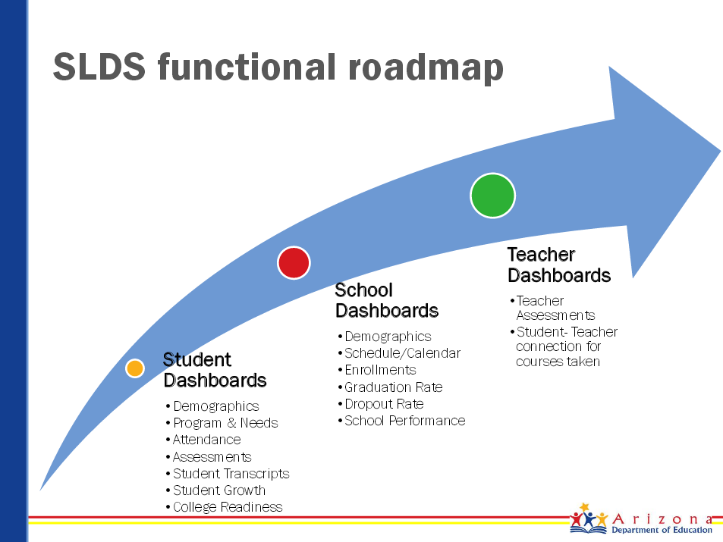
Arizona Dash- “Arizona Education Learning Accountability” System (AELAS) reports SLDS Data (cont…) http://www.azed.gov/aelas/az-dash/
http://www.azed.gov/information-technology/files/2012/04/ade-it-presentation-to-k12-cio_cto-confernce.pdf
Notes:
This is the “Functional Roadmap” for Arizona’s SLDS system. What percentage of the SLDS is completed in Arizona?

Slide 31
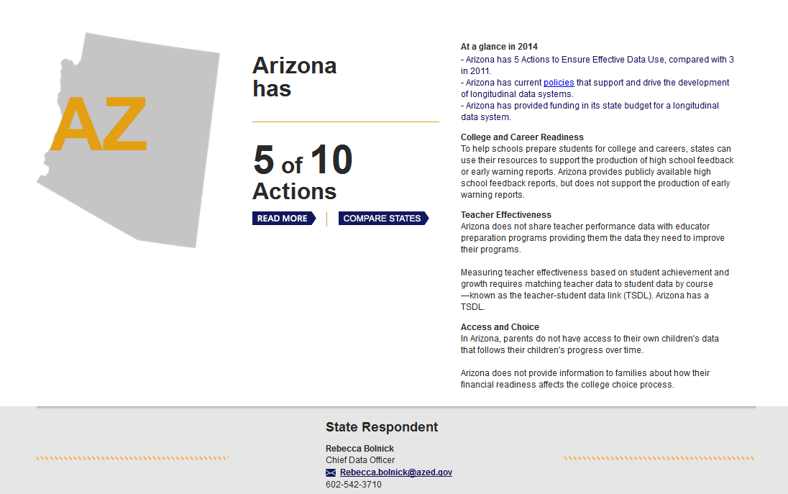

Data Quality Governance (DQG) Campaign-
Measures State’s Progress on SLDS Data Reporting http://dataqualitycampaign.org/your-states-progress/by-state/overview/
Notes:
Arizona is at 50% complete with our SLDS system according to the “Data Quality Governance (DQG) Campaign.” So how is this measured?

Slide 32
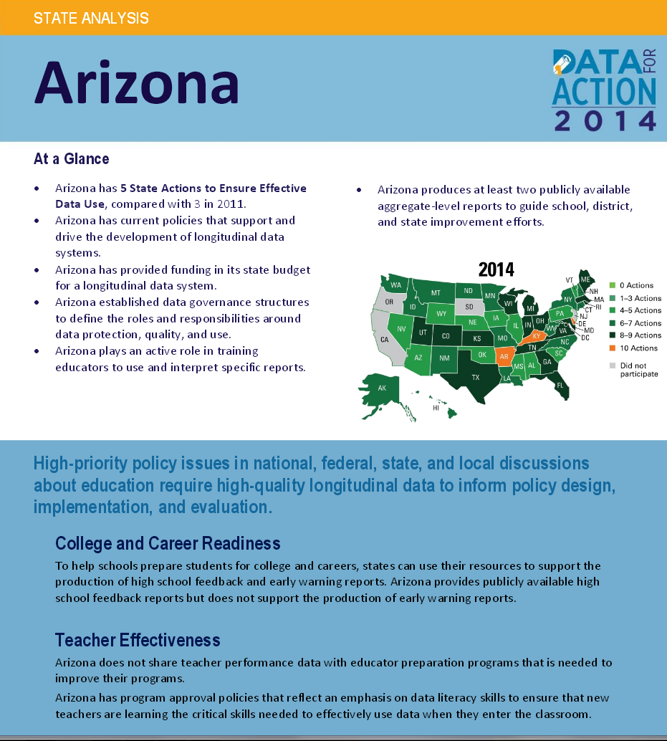
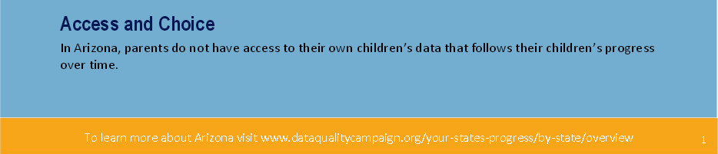
Data Quality Governance (DQC) Campaign-
Arizona’s Progress on SLDS Data Reporting http://dataqualitycampaign.org/files/pdf/stateprofiles/AZ.pdf
Notes:
There is a report with the DQC for each state on their current progress. This latest report was published in 2014.

Slide 33
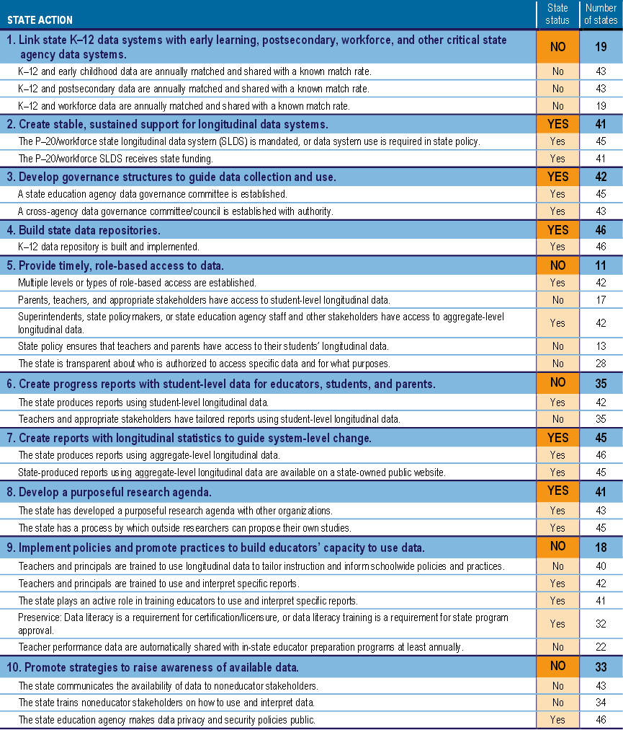
Data Quality Governance (DQC) Campaign-
Arizona’s Progress on SLDS Data Reporting (cont..) http://dataqualitycampaign.org/files/pdf/stateprofiles/AZ.pdf
Notes:
There are 10 “State Action” Items that are reported to the DQC. These are the questions that are answered and how our state is determined to be graded at a 5 out of 10 or a 50%.

Slide 34

HR5 (Student Success Act) https://www.congress.gov/bill/114th-congress/house-bill/5 {656 pages}
HR5 denigrates parental rights and seizes state sovereignty.
    No program shall “operate within a State, unless the legislature of that State shall have . . . waived the State’s rights and authorities to act inconsistently with any requirement that might be imposed by the Secretary as a condition of receiving that assistance.” (Sec. 6561) (emphasis added).
    Federal requirements will trump the rights “reserved to the States and individual Americans by the United States Constitution” to lead in the education of their child. (Sec. 6564)
    Requires states to change laws and regulations to “conform” to HR5. (Sec. 1403)
    Alters the governance structures of states by requiring them to form “Committees of Practitioners” to whom the state must submit rules and regulations. (Sec. 1403)
HR5 does nothing to relieve children from “No-Child-Left-Behind’s (NCLB’s) oppressive testing requirements.
Feds will effectively direct state education policy through enhanced continuation of heavy-handed NCLB policies.
    Requires states to demonstrate to the federal government that their standards, assessments, and state accountability systems meet the goal of “prepar[ing] all students to graduate high school for postsecondary education or the workforce.” (Sec. 1001)
    Requires states to submit comprehensive state plans, which the Secretary can disapprove. (Sec. 1111)
    States had to make the same showing and meet the same definitional goal to receive NCLB waivers and Race to the Top grants.. HR5 allows for a Common Core “rebrand.” (Sec. 1001) and (Sec. 1111(3)(A))
    Prohibitions against the Secretary forcing states into adopting Common Core are meaningless.
Increases federal data collection to control curriculum.
    Empowers the Department of Education to request individual student and teacher data from State and Local Education Agencies.
    Authorizes substantial new funding to use this data to evaluate whether schools are using “effective” instructional methods. (Sec. 2111(b)(1)(A)) and (Sec. 2132)
Congressman Salmon added an amendment to this bill so parents can “opt out” of federal assessments. However, since the language in HR5 only called out "federal assessments," this would only encompass the National Assessment for Educational Progress (NAEP) assessment which is administered by the federal government. The NAEP has never been a mandatory test so opting out of this assessment can already be done! Opt out language would need to pertain to ALL assessments which are state administered for the purpose of satisfying the federal testing requirements of NCLB/ESEA. This bill does not protect the states from high-stake, statewide assessments (aka AzMERIT)!
Current Status of HR5- Passed through the House on July 8, 2015 with a 218-213 vote with 3 not voting. Contact our Senators today and tell them to VOTE NO on HR5! {https://www.govtrack.us/congress/bills/114/hr5}
http://truthinamericaneducation.com/common-core-assessments/action-alert-stop-the-student-success-act-hr-5/
https://parentsagainstthecommoncore.com/action-alert-stop-the-student-success-act-hr-5/
Notes:
Data Mining will be expanded with Congressional legislation HR5 and S. 1177. This details how NCLB will be expanded under HR5- data collection will be expanded to control curriculum. However, an amendment was added to HR5 by Congressman Salmon to exempt parents from “federal assessments” which would only encompass the NAEP assessment. This bill does not protect the state from high-stake, statewide assessments (aka AzMERIT)!

Slide 35
S.1177 (Every Child Achieves Act- ECAA) http://www.cbo.gov/publication/50172 {792 pages}
ECAA removes the requirements for Adequate Yearly Progress (AYP) and specific sanctions for low-performing schools.
Participation in federal programs under NCLB and the proposed ECAA requires that each state submit an application, or “state plan,” to the U.S. Department of Education (USED).
    The state must demonstrate how its education system — including standards, assessments, accountability, and other components — will comply with the conditions of the legislation. If the Secretary of Education determines that a state plan fails to meet all those requirements, and if the state refuses to make the recommended changes, the Secretary has the authority to disqualify the state.
    Under Sec.1111(a)(4), a state plan can be disqualified “[i]f the Secretary determines that a State plan does not meet the requirements of this subsection or subsection (b) or (c),” which includes standards, assessments and state accountability systems.
    If a state can’t “demonstrate” to the Secretary’s satisfaction how the standards submitted in its application align to public university entrance requirements, career and technical education (CTE) standards, and the early-learning guidelines of the Child Care Development Block Grant (CCD), the Secretary may demand changes to the standards. And states have little, if any, direct control over the standards required under these three areas:
        “ECCA: (D) ALIGNMENT.—Each State shall demonstrate that the challenging State academic standards are aligned with—“(i) entrance requirements, without the need for academic remediation, for the system of public higher education in the State; (ii) relevant State career and technical education standards; and (iii) relevant State early learning guidelines, as required under section 658E(c)(2)(T) of the Child Care and Development Block Grant Act of 1990 (42 U.S.C. 9858c(c)(2)(T))”
        Consider the first alignment criterion: (i) entrance requirements, without the need for academic remediation, for any public institution of higher education in the state. This requirement may in fact ensure that the states will continue to use the Common Core standards.
The ECAA also diminishes state autonomy over education by requiring increased consultation and coordination with stakeholders in programs established under other federal legislation, such as the Child Care Development Block Grants administered through the Department of Health and Human Services.
The implications for states dealing with these new requirements for standards alignment are troubling. How would a state both align its standards to the requirements of the ECAA, and maintain any meaningful differentiation from other states or discretion over the substance of the standards? ECAA is not about emancipating the states from the control of USED, but rather about incorporating the states’ K-12 systems into the seamless web of federal government services, from cradle through the workforce.
Current Status of S. 1177- Up for a vote in the Senate this week! Contact our Senators today and tell them to VOTE NO on S. 1177! {https://www.govtrack.us/congress/bills/114/s1177}
http://truthinamericaneducation.com/elementary-and-secondary-education-act/the-danger-in-the-details-of-the-every-child-achieves-act-of-2015/
Notes:
S. 1177 removes the Adequate Yearly Progress requirement for the states for low-performing schools. However, it expands “control over of the federal government over the states through increased consultation and coordination with stakeholders in programs establish under other federal legislation,” thereby increasing the federal government’s control over the state through a “seamless web of federal services and control over their K-12 systems from cradle to the workforce.”

Slide 36


Example of National, Socialist Education at its Worst- Nazism! We can Stop This!
Orlean Kohle, “Common Core- A Trojan Horse for Education Reform.” (California Eagle Forum)
Notes:
I put this slide in here from my “Common Core Rotten to the Core” presentation to show you how similar the “Common Core System= Common Core Standards + Statewide Assessments+ Data Mining,” is as compared to this German youth pamphlet called “German Youth Belong to the Fuhrer!”

Slide 37
What can we do about data mining in Arizona? http://arizonansagainstcommoncore.com/Common_Core_Action_Items.pdf
Contact your two State Senators- John McCain and Jeff Flake and demand they VOTE NO on S. 1177!
Contact your one Congressman and demand he/she VOTES NO on HR5! (Already passed in House on July 8, 2105- contact Senators!)
Encourage our AZ Legislature to draft and support legislation that protects our student data from being shared with “outside entities.” Encourage our Arizona Legislature to draft legislation to “Get us Out” of the Statewide Longitudinal Data System (SLDS) and to protect our student data.
Contact Superintendent Diane Douglas and demand that her department not share any student data, including aggregated and personal identifiable information (PII) data, with “outside entities” without parental consent!
  Contact Superintendent Douglas by e-mail and phone: Diane.Douglas@azed.gov or 602-542-5423.
Fill out “Opt Out” forms for data mining and the AzMERIT exam from “OptOutAZ.org”: http://www.optoutaz.org/print-opt-out-forms/
Join “Arizonans Against Common Core” and “Opt Out AZ” so you can know what other action items to take to “Restore Local Control” by stopping the “Common Core System”= Common Core Standards + AzMERIT assessment + Data Mining!: AzSchoolChoice@cox.net and Gina@OptOutAZ.org
Share this presentation with your communities and your legislators- Available on the website at: http://arizonansagainstcommoncore.com/news.html
Notes:
So is there ANYTHING we can do to stop this data mining in our state? YES there is!

Slide 38
Any Questions?
We are doing more presentations in our state, contact us for further details: AZSchoolChoice@cox.net or Gina@OptOutAZ.org

